Slide 1
SOCIAL BUZZ Data analysis
Project Title

Slide 2
AGENDA
Introduction​
Project recap
The Analytic Team
Problem
​Yearly Performance
Process
Insights
​Summary​

Slide 3
Introduction
Social Buzz was founded by two former engineers from a large social media conglomerate, one from London and the other from San Francisco. They left in 2008 and both met in San Francisco to start their business. They started Social Buzz because they saw an opportunity to build on the foundation that their previous company started by creating a new platform where content took center stage. Social Buzz emphasizes content by keeping all users anonymous, only tracking user reactions on every piece of content. There are over 100 ways that users can react to content, spanning beyond the traditional reactions of likes, dislikes, and comments. This ensures that trending content, as opposed to individual users, is at the forefront of user feeds.

Slide 4
Project Recap
Social Buzz is a fast growing technology unicorn that need to adapt quickly to it's global scale.
Accenture has begun a 3 month POC focusing on these tasks:
• An audit of Social Buzz's big data practice
• Recommendations for a successful IPO
• Analysis to find Social Buzz's top 5 most popular categories of content

Slide 5
MEET OUR TEAM
Managing Director
Industry Lead
Data Scientist
Data Analyst Intern
​
Mae Mulligan
Susan Curtis
Michelle Grove
Tanu Rajput

Slide 6
Problem
Over 100000 posts per day
36,500,000 pieces of content per year
But how to capitalize on it when there is so much?

Slide 7
yearly PERFORMANCE

Slide 8
Content Distribution

Slide 9
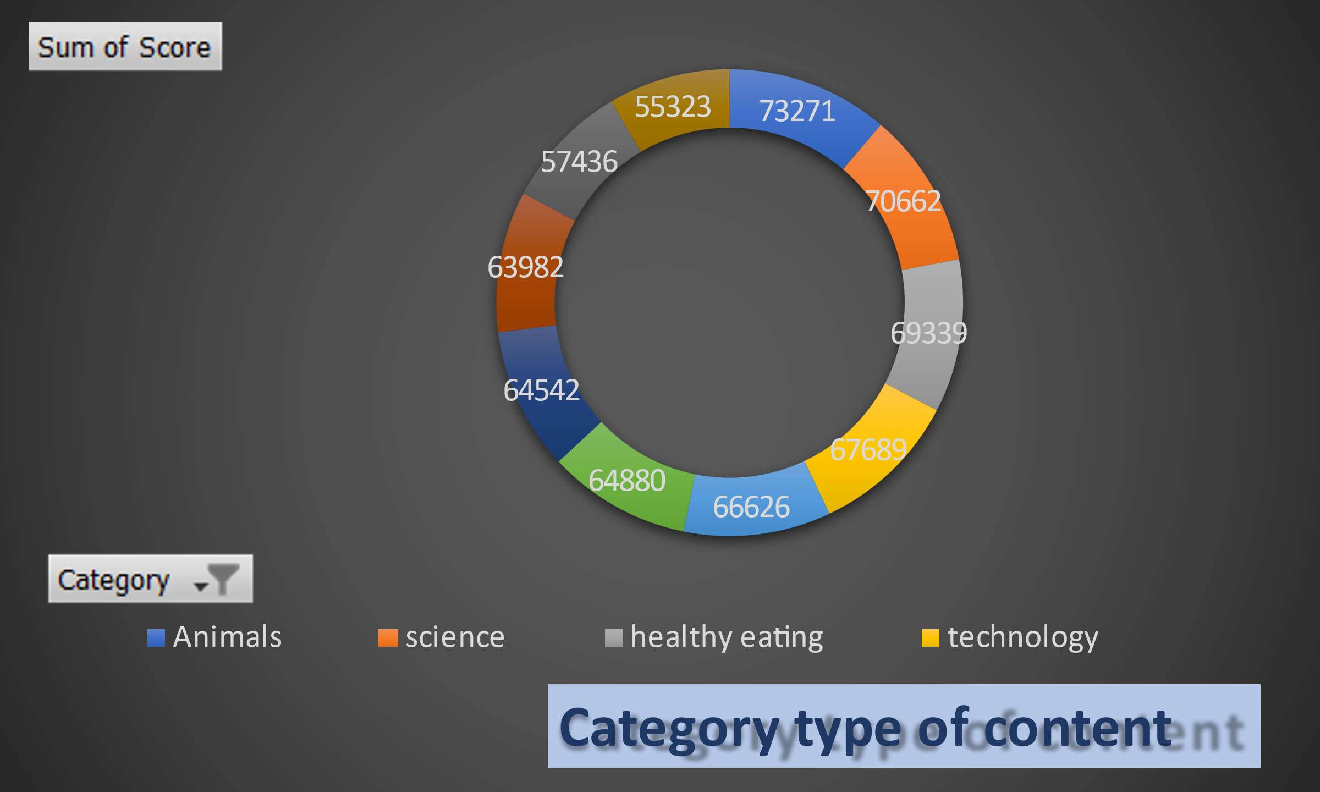
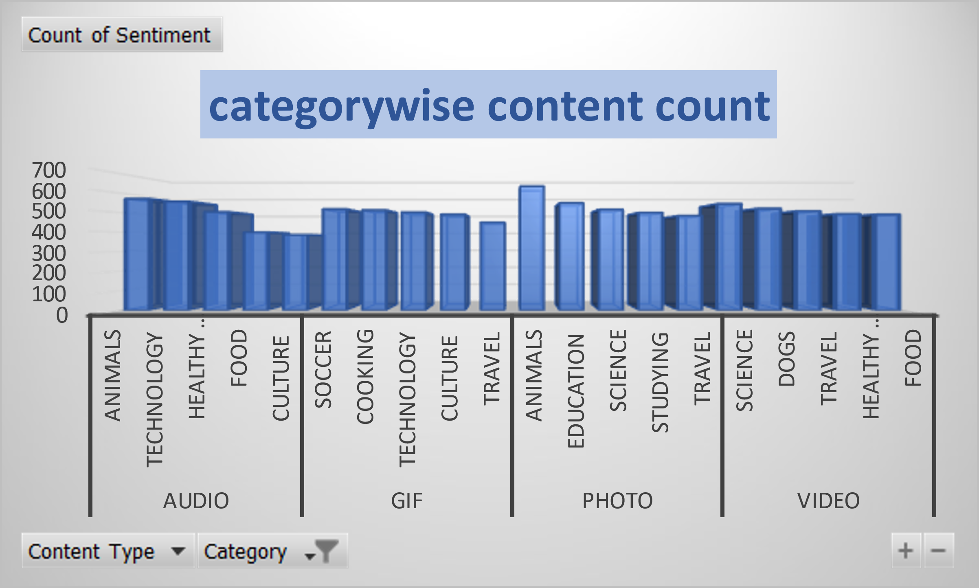

Slide 10
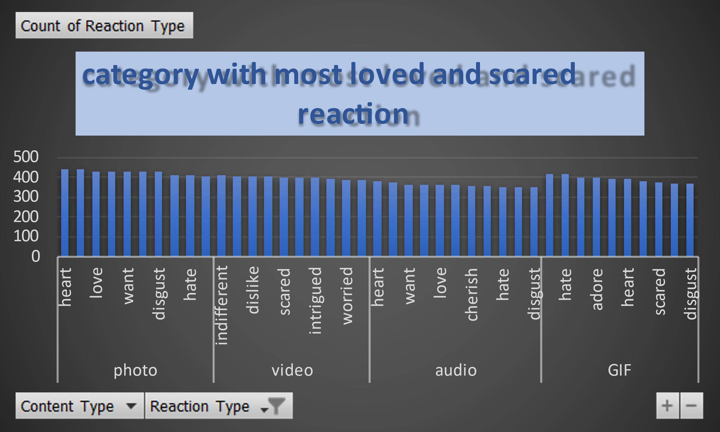
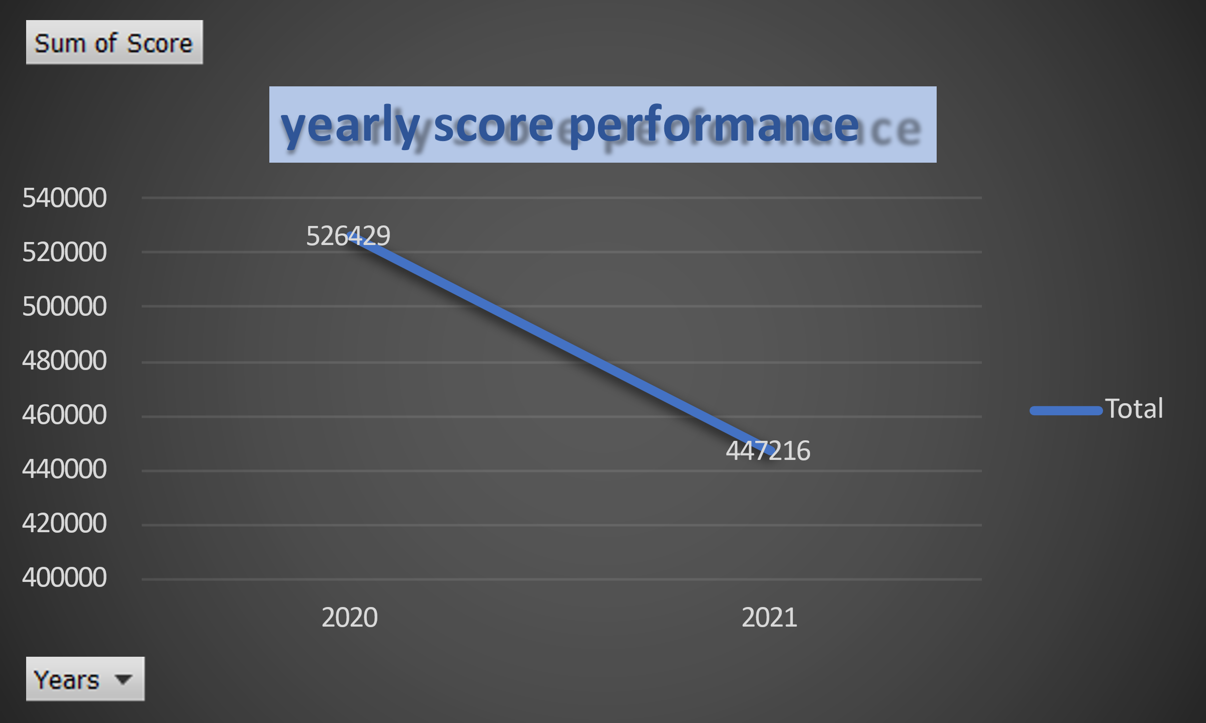

Slide 11





Process
Understand data
Data Cleaning and Modelling
Visualization
Insights
Presentation
Understand all requirements of user
We gather , merge,clean the data
by using excel
Pictorial representation of our data
Meaningful insights to take decisions
Present it to the user with insughts.

Slide 12
Insights
Scores are highest In 2021 compare to 2021
Too longy Gifs are disliked by people
Most uploaded categories are animals,science,education
Public likes photos and videos content most

Slide 13
SUMMARY
At Contoso, we believe in giving 110%. By using our next-generation data annotators,.
1).They are looking to complete an IPO by the end of next year and need guidance to ensure that this goes smoothly.
2) They are still a small company and do not have the resources to manage the scale that they are currently at. They could hire more people, but they want an experienced practice to help instead.
3) They want to learn data best practices from a large corporation. Due to the nature of their business, they have a massive amount of data so they are keen on understanding how the world's biggest companies manage the challenges of big data.
To start our engagement with Social Buzz, we are running a 3 month initial project in order to prove to them that we are the best firm to work with. They are expecting the following: -
An audit of their big data practice - Recommendations for a successful IPO - An analysis of their content categories that highlights the top 5 categories with the largest aggregate popularity
NEXT STEPS::==
This ad-hoc analysis is insightful, but it's time to take this analysis into large scale production for real-time understanding of your business. We can show you how to do this.

Slide 14
THANK YOU

